Slide 1
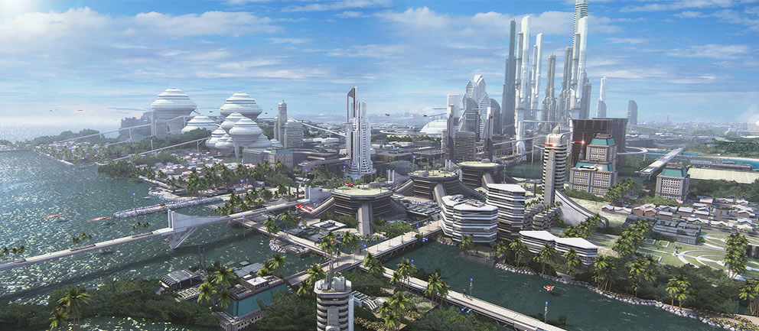
Road Mapping the Future
State of Innovation Ecosystems
G. Nagesh Rao
Chief Technologist SBA-OII
2016 USA Eisenhower Fellow
Source: Google Images

Slide 2
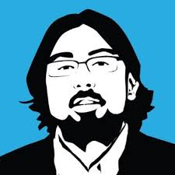
A Little bit of Info about me & My Current Efforts...
2016 USA Eisenhower Fellow
Son of Immigrant Entrepreneurs & got into family business at age 14
Engineer & Technologist trained at RPI w/summer research stints at Cornell
Worked in IP-Law, Public-Policy, Science & Commerce fields since 2002
Projects I have helped initiate include i6 Green, Patents for Humanity, FLoW, VT-Arc Additive Manufacturing Challenge, etc...
Been part of a few startups and have advised a number of them and investors ranging from social media to clean tech to space to materials science companies
Currently serve as an Advisor to LAUNCH, MAS Holdings, Village Capital, & AAAS-Lemelson Invention Ambassadors program
Among my many activities, currently working as a Public Servant and helping manage & execute oversight of an annual $2.5 Bln govt innovation fund

Slide 3
What do we actually do?
In the Small Business Act of July 30, 1953, Congress created the Small Business Administration, whose function is to "aid, counsel, assist and protect, insofar as is possible, the interests of small business concerns." The charter also stipulates that SBA would ensure small businesses a "fair proportion" of government contracts and sales of surplus property.
“3 C’s & a D”— capital, contracting, counseling, & disaster
SBA-OII primary work w/ 11 participating federal agencies on efforts related to the 3C’s from both policy and programmatic oversight.
Notes:
The first C is capital. If you’re looking for a way to finance your growth, an SBA loan might be what you need. The SBA doesn’t actually make the loans. Instead, we guarantee a percentage of each loan made by lenders who partner with us. Our guarantee reduces the risk, which means these SBA lending partners are more likely to help small businesses that can’t get access to conventional loans.
The second C is contracts. The federal government spends $500 billion a year in contracts. We work with all federal agencies to put at least 23 percent of that money in the hands of small businesses. We also work with small business directly, through training and business development programs, to help them compete for and win contracts.
The third C is counseling. Our nationwide network includes 68 district offices, nearly 900Small Business Development Centers, 110 Women’s Business Centers, and 350 chapters ofSCORE. These business experts offer counseling and training (nearly always free) to over 1 million small business owners each year. If you don’t have a counselor or mentor, you should. Our data shows that businesses that spend three hours or more with an SBA counselor have higher revenue and more employees as a result.

Slide 4
SBA’s Office of Investment and Innovation (OII) leads programs that provide the high-growth small business community with access to two things: financial capital and R&D funds to develop commercially viable innovations.
Our work is underpinned by public-private partnerships that operate on or along a very dynamic and economically important intersection.
Technology-Driven Innovation
Innovation
Innovatio
Private Sector
Private Sector
OII
OII
Finance &
Capital
Research & Development
Public Sector
Public Sector
Investment
High-Growth Entrepreneurship
Investment
Small Business Investment Company (SBIC) Program delivers access to financial capital
$4 billion authorization per year | $23.78 billion of assets under management | 299 active SBICs
Small Business Innovation Research (SBIR) and Small Technology Transfer Research (STTR) programs support the R&D + financing of cutting-edge technologies
~$2.5 billion annual set aside | ~145,000 awards granted | ~10 patents per day
Innovation - Support the American high growth entrepreneurial ecosystem
$4m Accelerator Program | Start-Up America | Demo Days | Crowdfunding

Slide 5
America’s Seed Fund-SBIR/STTR Programs
Small Business Innovation Research (SBIR) and Small Business Technology Transfer (STTR) programs
Supports R&D and financing of cutting edge technologies
$2.5 billion annual set aside
~145,000 awards granted
~10 patents per day
SBIR programs have awarded over $43 billion to research-intensive American small businesses
Key catalytic funding for thousands of high-tech small businesses and countless revolutionary technologies

Slide 6
SBIR & STTR in Brief
Quick Stats
What We Do @ 15,000 FT
FY 2015
SBIR
4358 Total Awards | 54% of $ to 10 States
Phase I Awards | 64% of Awards | 24.2% of Funds | Average Size $151,000
Phase II Awards | 36% of Awards | 75.8% of Funds | Average Size $718,000
23% to women-owned, minority-owned or HUBZone-located small biz
2.5% pre-2011 | 3.2% by 2017 | Floor NOT Cap
STTR
730 Total Awards | 78% DOD and HHS
Phase I Awards | 75% of Awards | 42% of Funds | Average Size $144,000
Phase II Awards | 25% of Awards | 58% of Funds | Average Size $582,000
22% to women-owned, minority-owned or HUBZone-located small biz
0.3% pre-2011 | 0.6% by 2017 | Floor NOT Cap
Typical Application Process
Solicitation
Topics
Proposal
Submission
Evaluation
Phase I or II Award

Slide 7
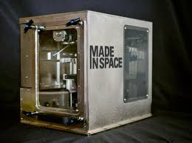
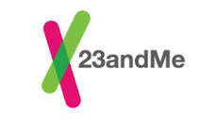
Why i work on america’s seed fund?
https://www.sbir.gov/news/testimonials
Front row seat to the future...

Slide 8
What is an Innovation Ecosystem ?
Source: STOA Europa- http://www.europarl.europa.eu/stoa/cms/home/events/workshops/value

Slide 9
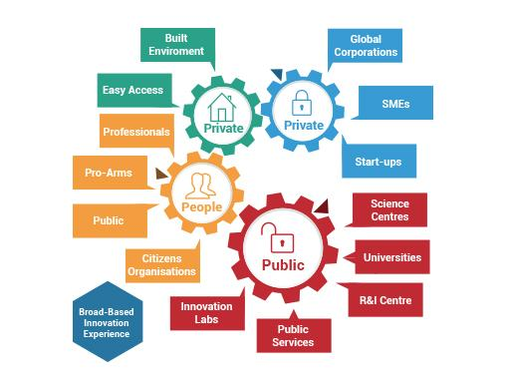
Innovation ecosystem is the term used to describe the large and diverse array of participants and resources that contribute to and are necessary for ongoing innovation in a modern economy. (Source MASS Tech-USA)
Source:IgniteTech.org
Like a biological ecosystem, you have a particular cast of characters that interact, engage, and build off of each other’s strengths in a supportive and collaborative manner. These unique clusters tend to rally around particular areas of technological growth and interests that are supported through smart alignment of social, intellectual, and financial capital.

Slide 10
The GUIP Model for enabling innovation Ecosystems...
Government
Policy Frameworks & Incentivization
Critical Institutional & Infrastucture Financing
Smart & Pragmatic Regulations
University
Generators of Talent Pool & Intellectual Capital
Industry/Private Sector
Titans of Product Refinement & Commercialization
Follow on Funding & Scale Up
Ultimate public-private partnership of interest...

Slide 11
What types of innovation ecosystems are emerging Around the World...
Advanced Manufacturing Hubs
Defense Technology Clusters
IT & Cybersecurity
Clean Energy
Life Sciences
Agro-Tech

Slide 12
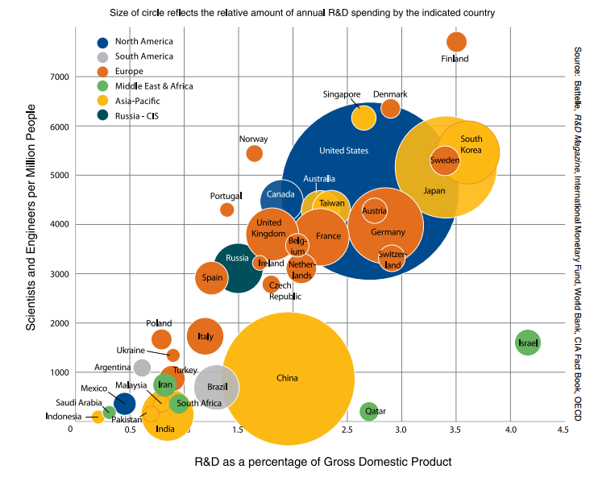
Data from 2014

Slide 13
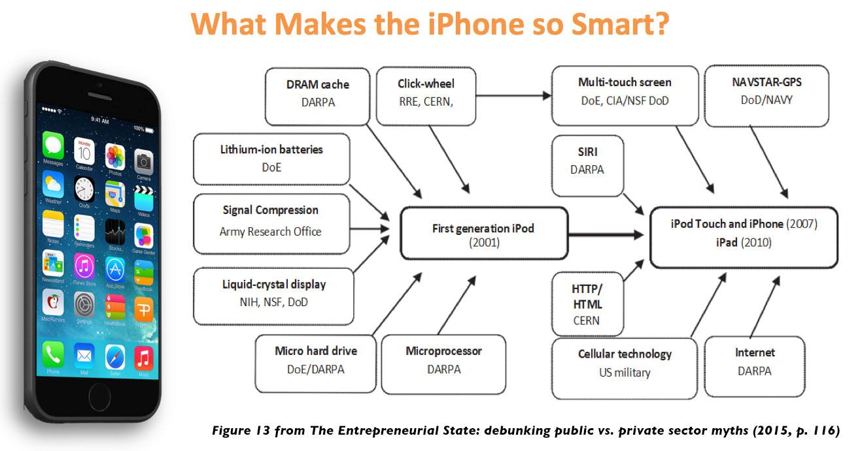
Think government can’t fuel innovation?

Slide 14
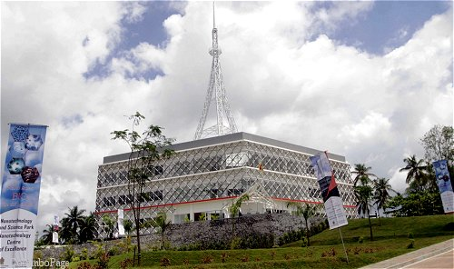
Case Example of Interest-SLINTEC-Sri Lanka
An ideal PPP, is a government service or private business venture that is funded and operated through a partnership of government and one or more private sector companies.
SLINTEC: Sri Lanka Institute of Nanotechnology
8 years since establishment...a leading center of excellence to help propel Sri Lanka’s prowess in Materials Science and Engineering.
Advanced materials development is a key industry of interest for next generation manufacturing.
This org serves as a Hub of excellence to facilitate an innovation ecosystem around Nanotechnology excellence...

Slide 15
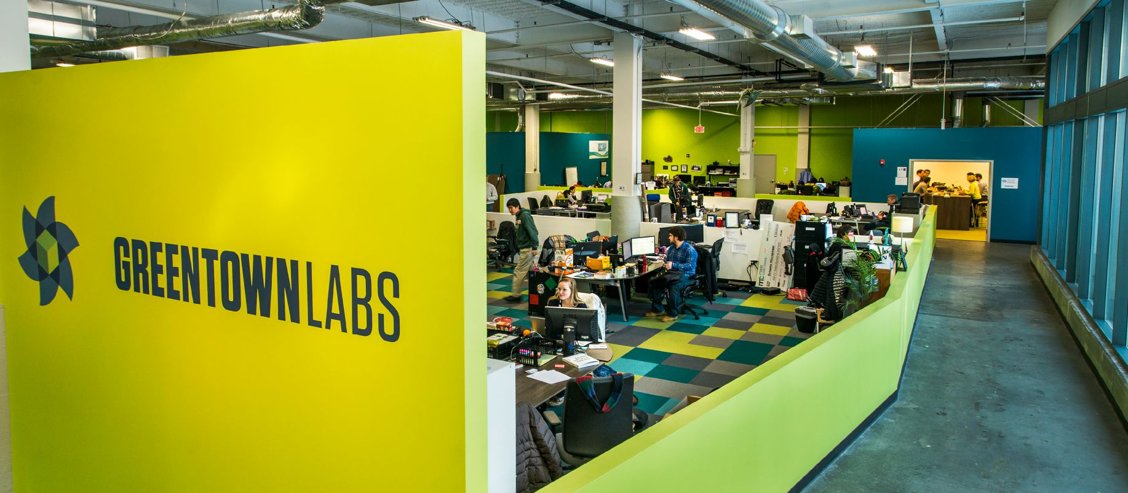
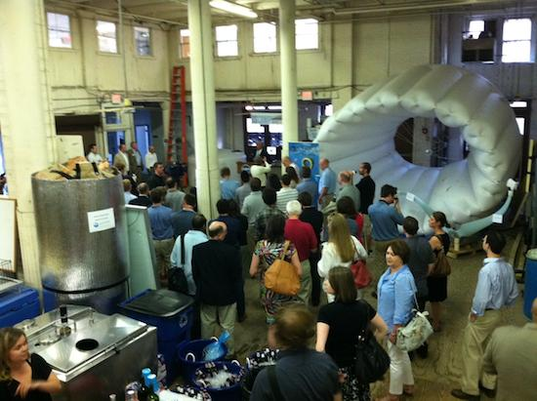
Case Example of Interest- Greentown labs-Boston-MA USA
Currently housing Over 40 cutting edge startup companies!
Partners include: GE, Veolia, SBA, & Wolf Greenfield...
Started by 4 entrepreneurial cleantech companies that needed space to work as they outgrew their makeshift operations at home and on MIT campus.
Grown over the last 5 years into a mega-hub for cleantech innovation excellence w/leading private & govt partners backing their efforts…

Slide 16
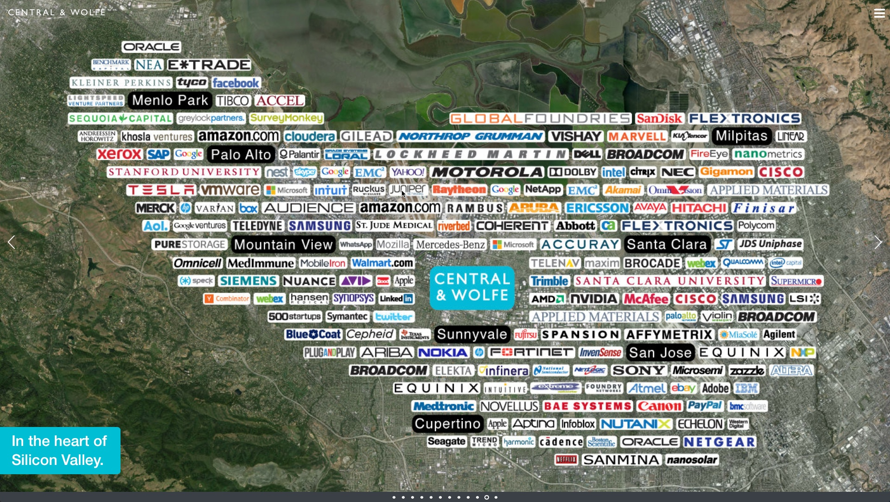
The Silicon Valley Ecosystem was NOT Built Overnight!
“Silicon Valley is a fertile technology crescent 50 years in the making. It is the product of Sputnik-induced competition, a 1960s induced cultural renaissance and an open-minded, risk-taking approach where failure is accepted. Silicon Valley cannot be replicated anywhere else, but the effects of its innovation will continue to be shared around the world.”
Source: Chris Haroun from Entrepreneur Magazine https://www.entrepreneur.com/article/240534

Slide 17
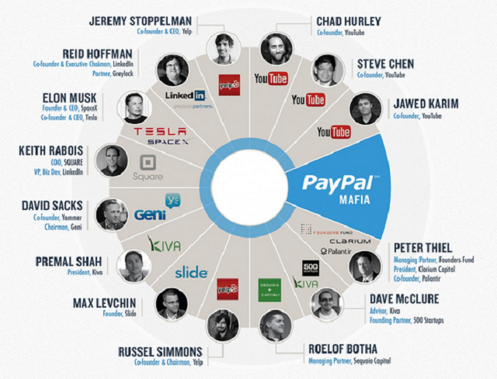
Invest & Reinvest in the Ecosystem to make it thrive...
Source: Google Images

Slide 18
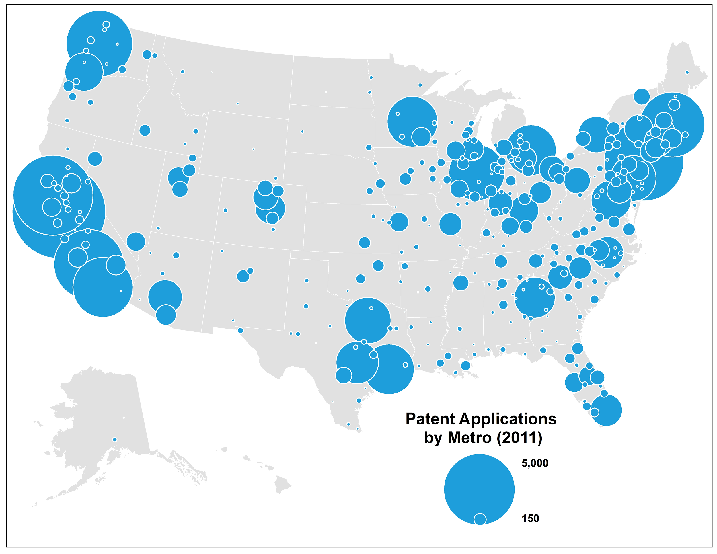
http://www.wipo.int/export/sites/www/pressroom/en/documents/wipi_2015_infographic.pdf
Source: CityLab

Slide 19
Sources: Edutopia & Ascend Intl. Respectively

Slide 20
Ensuring Intellectual Capital & Talent pipelines grow
PreK-12 Education
Immersion learning and exposure to STE(A)M enterprises
Research Universities & Liberal Arts Colleges
Multi-disciplinary focused curriculum
Free and Confluence modes of thinking and engagement
Perfect TBEDs to mitigate risk taking of novel ideas
Enable a culture of curiosity and cross-pollination

Slide 21
When & where does the Private Sector make sense?
What type of entity plays the perfect catalytic role for technology development?
Are major corporates the sole source of inspiring adoption and mainstream integration?
How do major corporates challenge themselves to embrace and adopt disruptive innovation early on?
Hint next slide tells the story of 2 small businesses and university research proving to be quite catalytic...

Slide 22
How a small business co. fueled 2 life science hubs in the us
Biogen & IDEC (pre-merger) subsisted on SBIR Awards dating back to 1986 and 1985 (respectively)
Biogen’s core technology emanated out of MIT labs via Professor & Nobel Laureate Phil Sharp, & IDEC’s core technology came from UC San Diego via Professor Ivor Royston
SBIR Funding proved to be catalytic fuel for technology’s development from university labs into marketplace.
Market Cap $60.46 Bln
More than 7,000 employees

Slide 23
Commercialization Scale Up & Targeted Assistance
Regional Innovation Clusters
Incubators
Growth Accelerators
Small Business Development Centers
Public Research Labs

Slide 24
Crucial ingredients to make an innovation ecosystem work
Freedom to innovate & operate
Strong rule of Law (IP, Tax, Contract)
Multidisciplinary-driven environment
Strong embrace for diverse thinking
Support and encourage immigration of talented folks
Culture of competitive collaboration
Willing to play the long game
Smart and agile regulatory framework
A system willing to reinvent itself over and over
Strong culture of mentorship

Slide 25
Benefits from a thriving innovation ecosystem
Source: Up Global

Slide 26
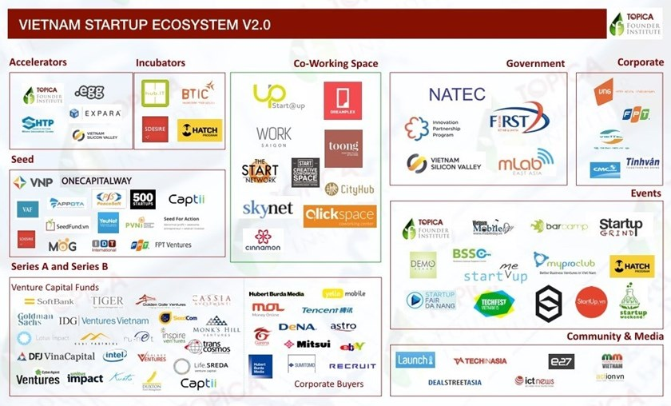

Slide 27
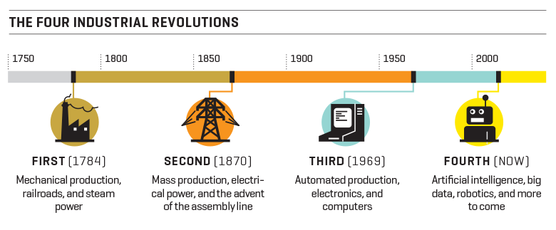
Source: http://fortune.com/2016/03/08/davos-new-industrial-revolution/ via World Economic Forum

Slide 28
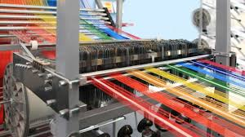
What innovation ecosystems make sense for sri lanka?
Source: Google Images

Slide 29
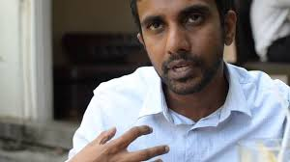
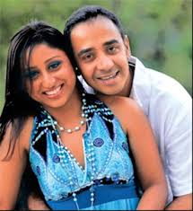
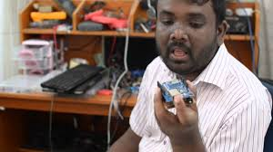
Future positive Entrepreneurial #changeAgents for SL!
Lahiru Pathmalal-Takas.lk
Source: IPS
Charitha Abeyratne & Prasanna Hettiarachchi
Saraii Village & Saaraketha
Source: Dailynews.LK
Kalinga Athulathmudali-TechKatha
Source: IPS
Entrepreneurship knows no race, creed, gender, age, etc...

Slide 30
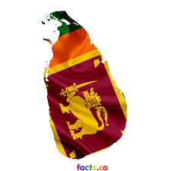
Be Bold…solve a problem for a Billion people in mind…
Let’s make sure Sri Lanka rises together collectively and positively for a brighter future through the power of entrepreneurship for all...

